Slide 1
Case #6: Seminar on The Legal Side of Risk Management and the Hub Oil Incident (recommend print ONE copy per 2 people / TWO copies per team)

Slide 2
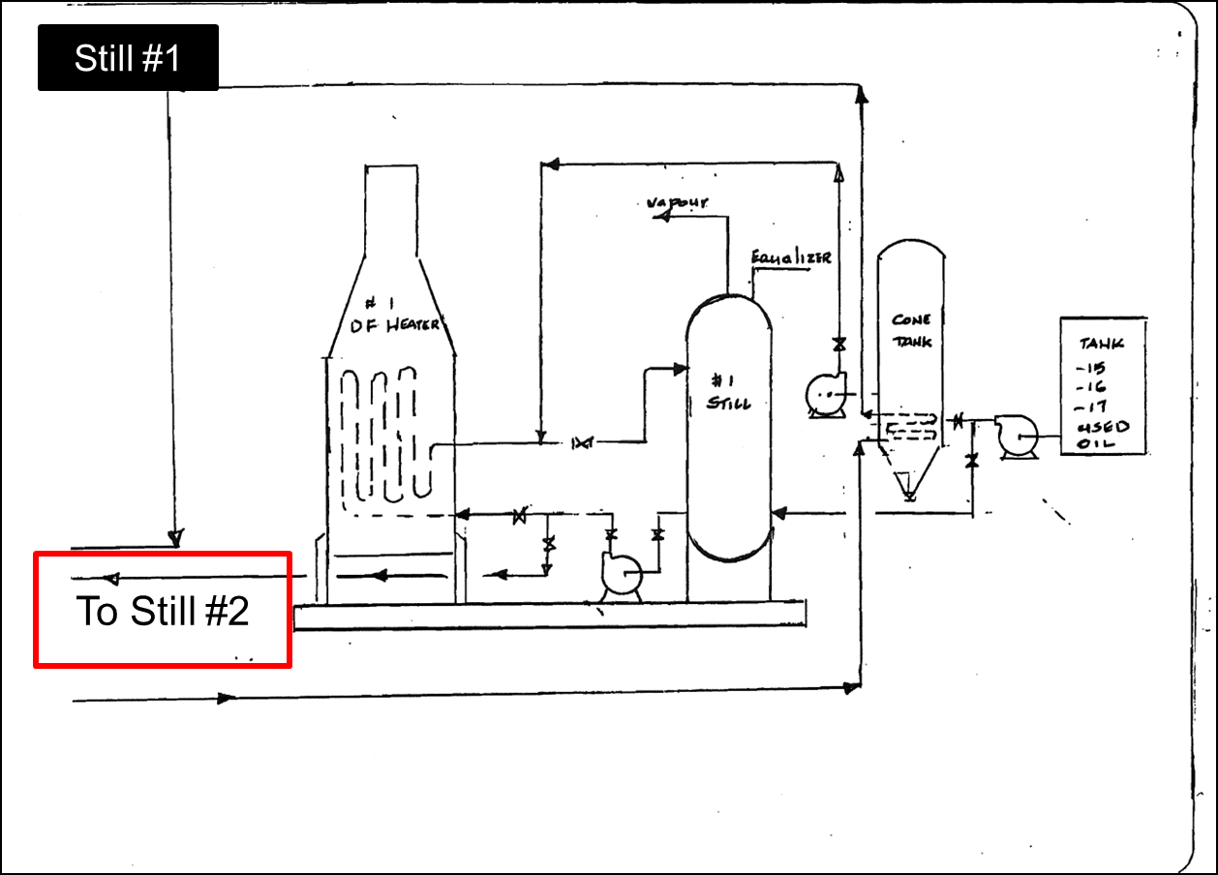

Slide 3
